Slide 1


CSCE 692 Design Principles of Computer Architecture Lecture 4a Chap 3– Instruction Level Parallelism
Dr. Scott Graham
AFIT/ENG
Notes adapted from
David Patterson
Electrical Engineering and Computer Sciences
University of California, Berkeley

Slide 2
Recall from Pipelining Review
Pipeline CPI = Ideal pipeline CPI + Structural Stalls + Data Hazard Stalls + Control Stalls
Ideal pipeline CPI: measure of the maximum performance attainable by the implementation
Structural hazards: HW cannot support this combination of instructions
Data hazards: Instruction depends on result of prior instruction still in the pipeline
Control hazards: Caused by delay between the fetching of instructions and decisions about changes in control flow (branches and jumps)

Slide 3
Instruction Level Parallelism
Instruction-Level Parallelism (ILP): overlap the execution of instructions to improve performance
More than just simple pipelining
2 approaches to exploit ILP:
Rely on hardware to help discover and exploit the parallelism dynamically
Desktop & server markets (e.g., Pentium 4, AMD Opteron, IBM Power)
Rely on software technology to find parallelism, statically at compile-time
Specialized & embedded (e.g., Itanium 2)

Slide 4
Instruction-Level Parallelism (ILP)
Basic Block (BB) ILP is quite small
BB: a straight-line code sequence with no branches in except to the entry and no branches out except at the exit
average dynamic branch frequency 15% to 25% => 3 to 6 instructions execute between a pair of branches
Plus instructions in BB likely to depend on each other
To obtain substantial performance enhancements, we must exploit ILP across multiple basic blocks
Simplest: loop-level parallelism to exploit parallelism among iterations of a loop. E.g.,
for (i=1; i<=1000; i=i+1) x[i] = x[i] + y[i];
Notes:
What do you notice about each iteration of this loop?

Slide 5
Loop-Level Parallelism
Exploit loop-level parallelism to parallelism by “unrolling loop” either by
dynamic via branch prediction or
static via loop unrolling by compiler
Determining instruction dependence is critical to Loop Level Parallelism
If 2 instructions are:
parallel, they can execute simultaneously in a pipeline of arbitrary depth without causing any stalls (assuming no structural hazards)
dependent, they are not parallel and must be executed in order, although they may often be partially overlapped

Slide 6
ILP and Data Dependencies, Hazards
HW/SW must preserve program order: order instructions would execute in if executed sequentially as determined by original source program
Dependences are a property of programs
Presence of dependence indicates potential for a hazard, but actual hazard and length of any stall is property of the pipeline
Importance of the data dependencies
1) indicates the possibility of a hazard
2) determines order in which results must be calculated
3) sets an upper bound on how much parallelism can possibly be exploited

Slide 7
Dependency Types
True Dependency
Part of the program data flow
Read after Write (RAW)
Name Dependency
Anti-Dependence
Write After Read (WAR)
Output Dependency
Write After Write (WAW)
Control Dependency
Branch dependencies must be maintained
Can Solve Name Dependencies via Register Renaming

Slide 8
FP Loop: Where are the Hazards?
We’ll use this code as an example of loop unrolling
for (i=1000; i>0; i=i–1)
x[i] = x[i] + s;
Assume following latencies for all examples
Ignore delayed branch in these examples
Instruction Instruction Latency in producing result using result clock cycles
FP ALU (ADD.D) Another FP ALU op 3
FP ALU (ADD.D) Store FP double 2
Load FP double FP ALU op 1
Integer op Cond Branch 1
Load FP double Store FP double 0
Integer op Integer op 0

Slide 9
FP Loop: Where are the Hazards?
First translate into MIPS code:
-To simplify, assume 8 is lowest address
Loop: L.D F0,0(R1) ;F0=vector element
ADD.D F4,F0,F2 ;add scalar from F2
S.D F4,0(R1) ;store result
DADDUI R1,R1,-8 ;decrement pointer 8B (DW)
BNEZ R1,Loop ;branch R1!=zero

Slide 10
FP Loop Showing Stalls
1 Loop: L.D F0,0(R1) ;F0=vector element
2 stall
3 ADD.D F4,F0,F2 ;add scalar in F2
4 stall
5 stall
6 S.D F4,0(R1) ;store result
7 DADDUI R1,R1,-8 ;decrement pointer 8B (DW)
8 stall ;assumes can’t forward to branch
9 BNEZ R1,Loop ;branch R1!=zero
Instruction Instruction Latency in producing result using result clock cycles
FP ALU op Another FP ALU op 3
FP ALU op Store double 2
Load double FP ALU op 1
9 clock cycles: Rewrite code to minimize stalls?

Slide 11
Revised FP Loop Minimizing Stalls
1 Loop: L.D F0,0(R1)
2 DADDUI R1,R1,-8
3 ADD.D F4,F0,F2
4 stall
5 stall
6 S.D F4,8(R1) ;altered offset when move DADDUI
7 BNEZ R1,Loop
Swap DADDUI and S.D by changing address of S.D
Instruction Instruction Latency in producing result using result clock cycles
FP ALU op Another FP ALU op 3
FP ALU op Store double 2
Load double FP ALU op 1
7 clock cycles, but just 3 for execution (L.D, ADD.D,S.D), 4 for loop overhead; How make faster?
Notes:
3 clocks doing work, 4 overhead (stall, branch, sub)

Slide 12
Unroll Loop Four Times (straightforward way)
1 cycle stall
1 Loop: L.D F0,0(R1)
3 ADD.D F4,F0,F2
6 S.D F4,0(R1) ;drop DADDUI & BNEZ
7 L.D F6,-8(R1)
9 ADD.D F8,F6,F2
12 S.D F8,-8(R1) ;drop DADDUI & BNEZ
13 L.D F10,-16(R1)
15 ADD.D F12,F10,F2
18 S.D F12,-16(R1) ;drop DADDUI & BNEZ
19 L.D F14,-24(R1)
21 ADD.D F16,F14,F2
24 S.D F16,-24(R1)
DADDUI R1,R1,-32 ;alter to 4*8
stall
27 BNEZ R1,LOOP
27 clock cycles, or 6.75 per iteration??
(Assumes R1 is multiple of 32, iterations is a multiple of 4)
2 cycles stall
Notes:
Why 27 and not 26? Still have a stall since assuming BNEZ must resolve in ID so must stall 1 cycle until R1 can be forwarded from DADDUI.
Note that F2 is holding ‘s’

Slide 13
Unrolled Loop That Minimizes Stalls
1 Loop: L.D F0,0(R1)
2 L.D F6,-8(R1)
3 L.D F10,-16(R1)
4 L.D F14,-24(R1)
5 ADD.D F4,F0,F2
6 ADD.D F8,F6,F2
7 ADD.D F12,F10,F2
8 ADD.D F16,F14,F2
9 S.D F4,0(R1)
10 S.D F8,-8(R1)
11 S.D F12,-16(R1)
12 DADDUI R1,R1,-32
13 S.D F16, 8(R1) ; 8-32 = -24
14 BNEZ R1,LOOP
14 clock cycles, or 3.5 per iteration

Slide 14
Compiler Perspectives on Code Movement
Definitions: compiler concerned about dependencies in program, whether or not a HW hazard exists for the dependency is a function of a given pipeline
Try to schedule instructions to avoid hazards
Data dependencies (RAW if a hazard for HW)
Instruction i produces a result used by instruction j, or
Instruction j is data dependent on instruction k, and instruction k is data dependent on instruction i.
If truly dependent, can’t execute in parallel
Easy to determine dependencies for registers (fixed names)
Harder for memory locations:
Does 100(R4) = 20(R6)?
From different loop iterations, does 20(R6) = 20(R6)?

Slide 15
Compiler Perspectives on Code Movement
Another kind of dependence called name dependence: two instructions use same name (register or memory location) but don’t exchange data
Anti-dependence (WAR if a hazard for HW)
Instruction j writes a register or memory location that instruction i reads from and instruction i is executed first
C=A+B OR ld R1, 12(R2) [instruction i]
B=D+E sd R3,12(R2) [instruction j]
Output dependence (WAW if a hazard for HW)
Instruction i and instruction j write the same register or memory location; ordering between instructions must be preserved.
C=A+B OR sd R1,12(R2) [instruction i] … …
C=2*D sd R3,12(R2) [instruction j]

Slide 16
Where are the name dependencies?
1 Loop: L.D F0,0(R1)
2 ADD.D F4,F0,F2
3 S.D F4,0(R1)
4 L.D F0,-8(R1)
5 ADD.D F4,F0,F2
6 S.D F4,-8(R1)
7 L.D F0,-16(R1)
8 ADD.D F4,F0,F2
9 S.D F4,-16(R1)
10 L.D F0,-24(R1)
11 ADD.D F4,F0,F2
12 S.D F4,-24(R1)
13 DADDI R1,R1,-32
14 BNEZ R1,LOOP
How can we remove them?
Notes:
LD F0 to output to next LD F0
ADD F0 input to LD F0

Slide 17
Where are the name dependencies?
1 Loop: L.D F0,0(R1)
2 ADD.D F4,F0,F2
3 S.D F4,0(R1)
4 L.D F6,-8(R1)
5 ADD.D F8,F6,F2
6 S.D F8,-8(R1)
7 L.D F10,-16(R1)
8 ADD.D F12,F10,F2
9 S.D F12,-16(R1)
10 L.D F14,-24(R1)
11 ADD.D F16,F14,F2
12 S.D F16,-24(R1)
13 DADDI R1,R1,-32
14 BNEZ R1,LOOP
Remove via Register Renaming
Allows these blocks of code to be reordered since independent
Notes:
LD F0 to output to next LD F0
ADD F0 input to LD F0

Slide 18
Compiler Perspectives on Code Movement
Again name dependencies are hard for memory accesses
Does 100(R4) = 20(R6)?
From different loop iterations, does 20(R6) = 20(R6)?
Our example required compiler to know that if R1 doesn’t change then: 0(R1) ≠ -8(R1) ≠ -16(R1) ≠ -24(R1)
There were no dependencies between some loads and stores so they could be moved past each other

Slide 19
Compiler Perspectives on Code Movement
Final kind of dependence called control dependence
Example
if p1 {S1;};
if p2 {S2;};
S1 is control dependent on p1 and S2 is control dependent on p2 but not on p1.

Slide 20
Compiler Perspectives on Code Movement
Two (obvious) constraints on control dependencies:
An instruction that is control dependent on a branch cannot be moved before the branch so that its execution is no longer controlled by the branch.
An instruction that is not control dependent on a branch cannot be moved to after the branch so that its execution is controlled by the branch.
Control dependencies can be relaxed to get parallelism
must not affect correctness of program
need to preserve order of exceptions and data flow (i.e., the value in registers that depend on branch)

Slide 21
Preserving Exception Behavior
Any changes in the ordering of instruction execution must not change how exceptions are raised in the program
We can reorder instructions if we can ignore exceptions that would not have occurred prior to the reordering
Moving L.D before branch
DADDU R2,R3,R4
BEQZ R2, L1
NOP
L.D R1, 0(R2)
L1:
We could move L.D before the branch because no data dependences exist
However, L.D could cause a memory protection exception
Conditional instructions and speculation (covered later) will overcome this problem

Slide 22
Preserving Data Flow
Sometimes data flow is dynamic or altered due to branches
DADD R1, R2, R3
BEQZ R4, L1
NOP
DSUB R1, R5, R6
L1: OR R7, R1, R8
Result of OR depends on R1 which is controlled by the branch (R4 value)
Note data dependence alone will not preserve correctness, there is also a control dependence that must be preserved (dynamic data flow)
Conditional instructions and speculation (covered later) will help overcome this problem too

Slide 23
When is it Safe to Unroll Loops?
Example: Where are data dependencies? (A,B,C distinct & non-overlapping)
for (i=1; i<=100; i=i+1) { A[i+1] = A[i] + C[i]; /* S1 */ B[i+1] = B[i] + A[i+1];} /* S2 */
1. S2 uses the value, A[i+1], computed by S1 in the same iteration.
2. S1 uses a value computed by S1 in an earlier iteration, since iteration i computes A[i+1] which is read in iteration i+1. The same is true of S2 for B[i] and B[i+1].
This is a “loop-carried dependence” between iterations
Implies that iterations are dependent and can’t be executed in parallel
Not the case for our prior example; each iteration was distinct
It’s possible that loops with a limited dependency may be parallelized

Slide 24
5 Loop Unrolling Decisions
Requires understanding how one instruction depends on another and how the instructions can be changed or reordered given the dependences:
Determine loop unrolling useful by finding that loop iterations were independent (except for maintenance code)
Use different registers to avoid unnecessary constraints forced by using same registers for different computations
Eliminate the extra test and branch instructions and adjust the loop termination and iteration code
Determine that loads and stores in unrolled loop can be interchanged by observing that loads and stores from different iterations are independent
Transformation requires analyzing memory addresses and finding that they do not refer to the same address
Schedule the code, preserving any dependences needed to yield the same result as the original code

Slide 25
3 Limits to Loop Unrolling
Decrease in amount of overhead amortized with each extra unrolling
Amdahl’s Law
Growth in code size
For larger loops, concern it increases the instruction cache miss rate
Register pressure: potential shortfall in registers created by aggressive unrolling and scheduling
If not be possible to allocate all live values to registers, may lose some or all of its advantage
Loop unrolling reduces impact of branches on pipeline; another way is branch prediction

Slide 26
Dynamic Branch Prediction
Prediction depends on behavior of branch at runtime and can change over time
Performance = ƒ(accuracy, cost of misprediction)
Branch History Table (BHT) is simplest
Small memory indexed by lower portion of address of branch instruction
Says whether or not branch taken last time
Lower bits of address indexes table of 1-bit values
No address check of upper bits
another branch could have set bit
Problem: in a loop, 1-bit BHT will cause two mispredictions:
End of loop case, when it exits instead of looping as before
First time through loop on next time through code, when it predicts exit instead of looping
Prediction bit
1
1
0
1
LSBs of PC
0

Slide 27
BHT Accuracy
BHT mispredicts because either:
Wrong guess for that branch
Got history of wrong branch when indexing the table
4096 entry table programs vary from 1% misprediction (nasa7, tomcatv) to 18% (eqntott), with spice at 9% and gcc at 12%
4096 entries is about as good as infinite table (in Alpha 21164)
Care to speculate why?

Slide 28
Dynamic Branch Prediction
Solution: 2-bit scheme where prediction is changed only if mispredicted twice:
Adds hysteresis to decision making process
Taken
Not taken
Predict taken
(00)
Predict taken
(01)
Taken
Taken
Not taken
Predict not
taken (11)
Not taken
Predict not
taken (10)
Taken
Not taken
Notes:
A system with hysteresis can be summarized as a system that may be in any number of states, independent of the inputs to the system. To be exact, a system with hysteresis exhibits path-dependence, or "rate-independent” memory

Slide 29
Dynamic Branch Prediction
Example: 2-bit vs. 1-bit prediction
Branch Outcome | T | T | T | N | T | T | T | N | T | T | T | N | % Predict rate
1-bit prediction | N | T | T | T | N | T | T | T | N | T | T | T
1-bit mis-predict? | Y |  |  | Y | Y |  |  | Y | Y |  |  | Y | ~ 50%
2-bit prediction | N | T | T | T | T | T | T | T | T | T | T | T
2-bit mis-predict? | Y |  |  | Y |  |  |  | Y |  |  |  | Y | ~ 75%
Notes:
Note assume starting in (1,1) for 2-bit predictor and a zero(NT) in the 1-bit predictor

Slide 30
Correlating Branch Predictors (Two-level Predictors)
2-bit scheme only looks at branch’s own history to predict behavior
What if we use other branches to predict it as well?
if (aa == 2) aa = 0;
if (bb == 2) bb = 0;
if (aa != bb) { … };
Branch #3 depends on the outcome of #1 and #2
Idea: record m most recently executed branches as taken or not taken, and use that pattern to select the proper branch history table
In general, (m,n) predictor means record last m branches to select between 2^{m} history tables each with n-bit counters
Old 2-bit BHT is then a (0,2) predictor

Slide 31
Correlating Branches
Branch address
(2,2) predictor:
Then behavior of recent branches selects between, say, four predictions of next branch, updating just that prediction
Pattern History Table
2-bits per branch local predictors for:
NN NT TN TT
4
Prediction
T
N
2-bit global branch history register
- shift register
- (behavior of last two branches)

Slide 32
Accuracy of Different Schemes
18%
4096 Entries 2-bit BHT
Unlimited Entries 2-bit BHT
1024 Entries (2,2) BHT

Slide 33
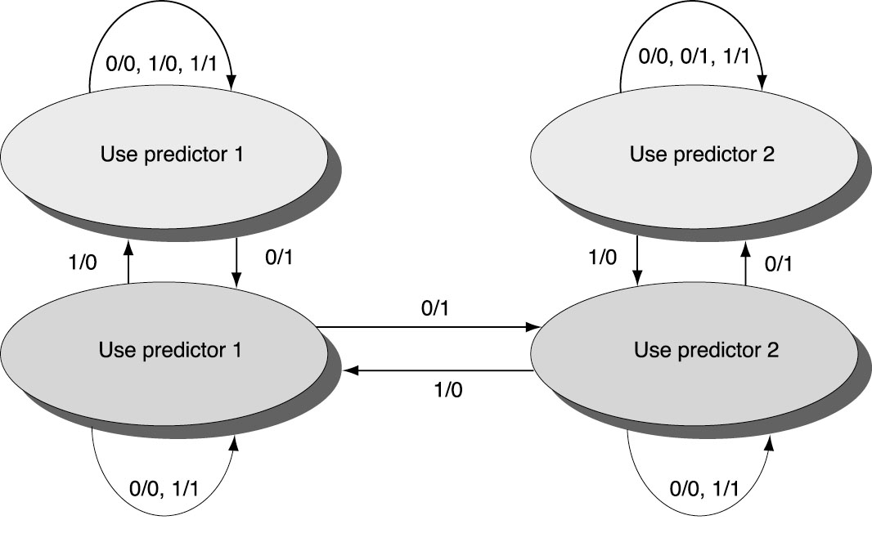
Tournament Predictors
Multilevel branch predictor
Use n-bit saturating counter to choose between predictors
Usual choice between global and local predictors

Slide 34
Tournament Predictors
Alpha 21264 tournament predictor: 4K 2-bit counters indexed by local branch address. Chooses between:
Global predictor
4K entries indexed by the history of the last 12 branches (2¹² ⁼ 4K)
Each entry is a standard 2-bit predictor
Local predictor
Local history table: 1024 10-bit entries recording last 10 branches, indexed by branch address
The pattern of the last 10 occurrences of that particular branch used to index table of 1K entries with 3-bit saturating counters

Slide 35
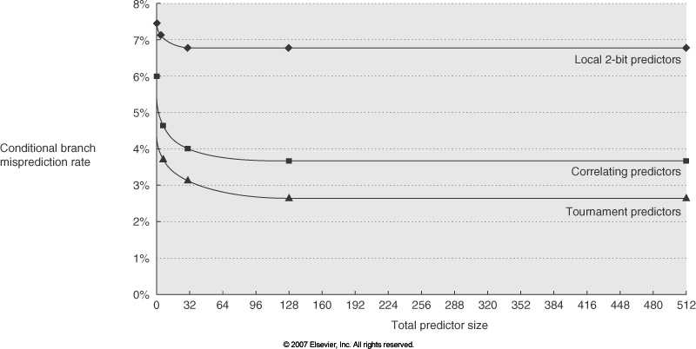
Comparing Predictors – SPEC89
Advantage of tournament predictor is ability to select the right predictor for a particular branch

Slide 36
Branch Target Buffers (BTB)
Branch target calculation is costly and stalls the instruction fetch.
BTB stores PCs the same way as caches
The PC of a branch is sent to the BTB
When a match is found the corresponding Predicted PC is returned
If the branch was predicted taken, instruction fetch continues at the returned predicted PC

Slide 37
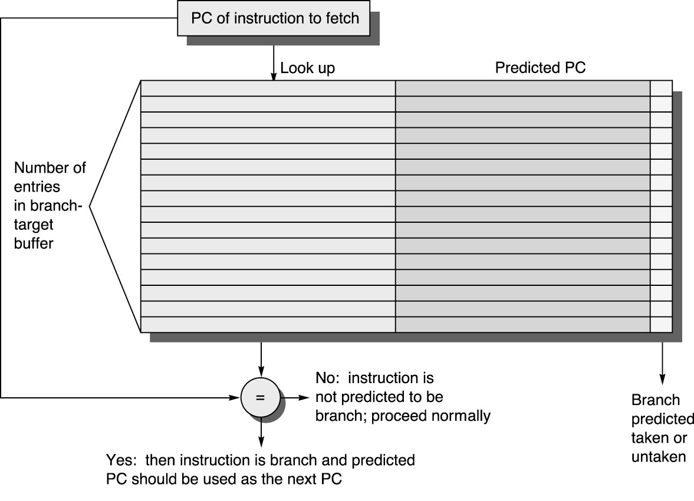
Branch Target Buffers
Notes:
Similar to a cache, we can store recent branches (if taken) and the predicted PC to target to. So before we even know it is a branch, we load the target as the next PC. If mispredicted, must kill as normal.

Slide 38
Dynamic Branch Prediction Summary
Prediction becoming important part of execution
Branch History Table: 2 bits for loop accuracy
Correlation: Recently executed branches correlated with next branch
Either different branches
Or different executions of same branches
Tournament predictors take insight to next level, by using multiple predictors
usually one based on global information and one based on local information, and combining them with a selector
In 2006, tournament predictors using ≈ 30K bits are in processors like the Power5 and Pentium 4
Branch Target Buffer: include branch address & prediction

